Slide 1
Key-Value Pair Detection in Documents
~ T.GOKUL ADETHYA, TEAM FROZENWOLF
Notes:
Good evening to everyone present here. My name is Gokul Adethya, and I am the only member of team FrozenWolf. I am currently a freshman at the National Institute of Technology Tiruchirappalli in the Computer Science Department and I am a Deep Learning enthusiast.

Slide 2
CONTENT
1) Introduction
2) Target
3) Dependencies and Requirements
4) Approach
ML modeling
Web App
5) Model Structure
CRAFT
Faster R-CNN
Tesseract
LSTM + Siamese Neural Network
6) Predict & Evaluate
7) Web App
8) Deploying Web App
9) Demo
Notes:
This is the content page, and we will be discussing these topics.

Slide 3
Introduction
I have chosen to solve the key-value pair detection in document problem. In this presentation, I will explain how I was able to host a live website that can convert a scanned document into editable text along with information like bounding boxes and value pair relations similar to the FUNSD dataset allows users to check live progress for the conversion. The website will also allow users to adjust the model output using the annotation feature. I have also made offline code to predict output for multiple PDF or image files with multiple pages in them and different codes for users to host websites locally from their PC. https://github.com/FrozenWolf-Cyber/OCR
Notes:
I have chosen to solve the key-value pair detection in document … problem. In this presentation, I will explain how I could host a live website that can convert a scanned document into editable text along with information like bounding boxes and key-value pair relations similar to the FUNSD dataset. It will also allows users to check live progress for the conversion in the ML model pipeline. The website will also allow users to adjust the model output using the annotation feature. I have also made offline code to predict the output for multiple PDF or image files with various pages in them and different programs for users to host websites locally from their PC.

Slide 4
TARGET
Detect key-value Pairs in a document that would involve the following:
Classify the phrase/fragment as ‘key,’ ‘value,’ or ‘other’ along with corresponding bounding boxes.
Linking information of the objects, i.e., linking key to its respective value.
3. A user-friendly web app that receives scanned documents from the user and gives the above-mentioned information to the user in return. It should also give the user the freedom to adjust the model output in an interactive and user-friendly manner.
Notes:
These are the targets that we need to achieve :
Classify the phrase/fragment as ‘key,’ ‘value,’ or ‘other’ along with corresponding bounding boxes
Linking these objects
A user-friendly web app that receives scanned documents returns the output in the mentioned format
Detecting key-value Pairs in a document would involve the following:
Classify the phrase/fragment as ‘key,’ ‘value,’ or ‘other’ along with corresponding bounding boxes.
Linking information of the objects, i.e., linking key to its respective value.
3. A user-friendly web app that receives scanned documents from the user and gives the above-mentioned information to the user in return. It should also give the user the freedom to adjust the model output in an interactive and user-friendly manner.

Slide 5
Dependencies and Requirements
DEPENDENCIES
tesseract-ocr
poppler-utils
REQUIREMENTS
Flask
pickle-mixin
Numpy
Pillow
Regex
Pdf2image
opencv-python
scikit-image
sklearn
Torchtorchvision
pytesseract
Notes:
These are the dependencies and requirements that need to be installed before running the web app locally
DEPENDENCIES
tesseract-ocr
poppler-utils
REQUIREMENTS
Flask
pickle-mixin
Numpy
Pillow
Regex
Pdf2image
opencv-python
scikit-image
sklearn
Torchtorchvision
pytesseract

Slide 6
APPROACH
ML MODELLING
Combining CRAFT, Faster R-CNN, Tesseract, and Siamese neural network models.
Image ➔ CRAFT ➔ Bounding boxes for each sentence
Image ➔ Faster R-CNN ➔ Regional bounding boxes of each label category
CRAFT output + Faster R-CNN output ➔ IOU scores ➔ Classify Labels
4) Image of each sentence ➔ Tesseract ➔Word bounding boxes & translations.
5) Bounding boxes + label + translation ➔ LSTM + Siamese Neural Network ➔ Key-Value Linking.
Notes:
We combine CRAFT, Faster R-CNN, Tesseract, and LSTM-Siamese neural network models to create a program that gives us label classification, bounding boxes, and key-value pair linking.

Slide 7
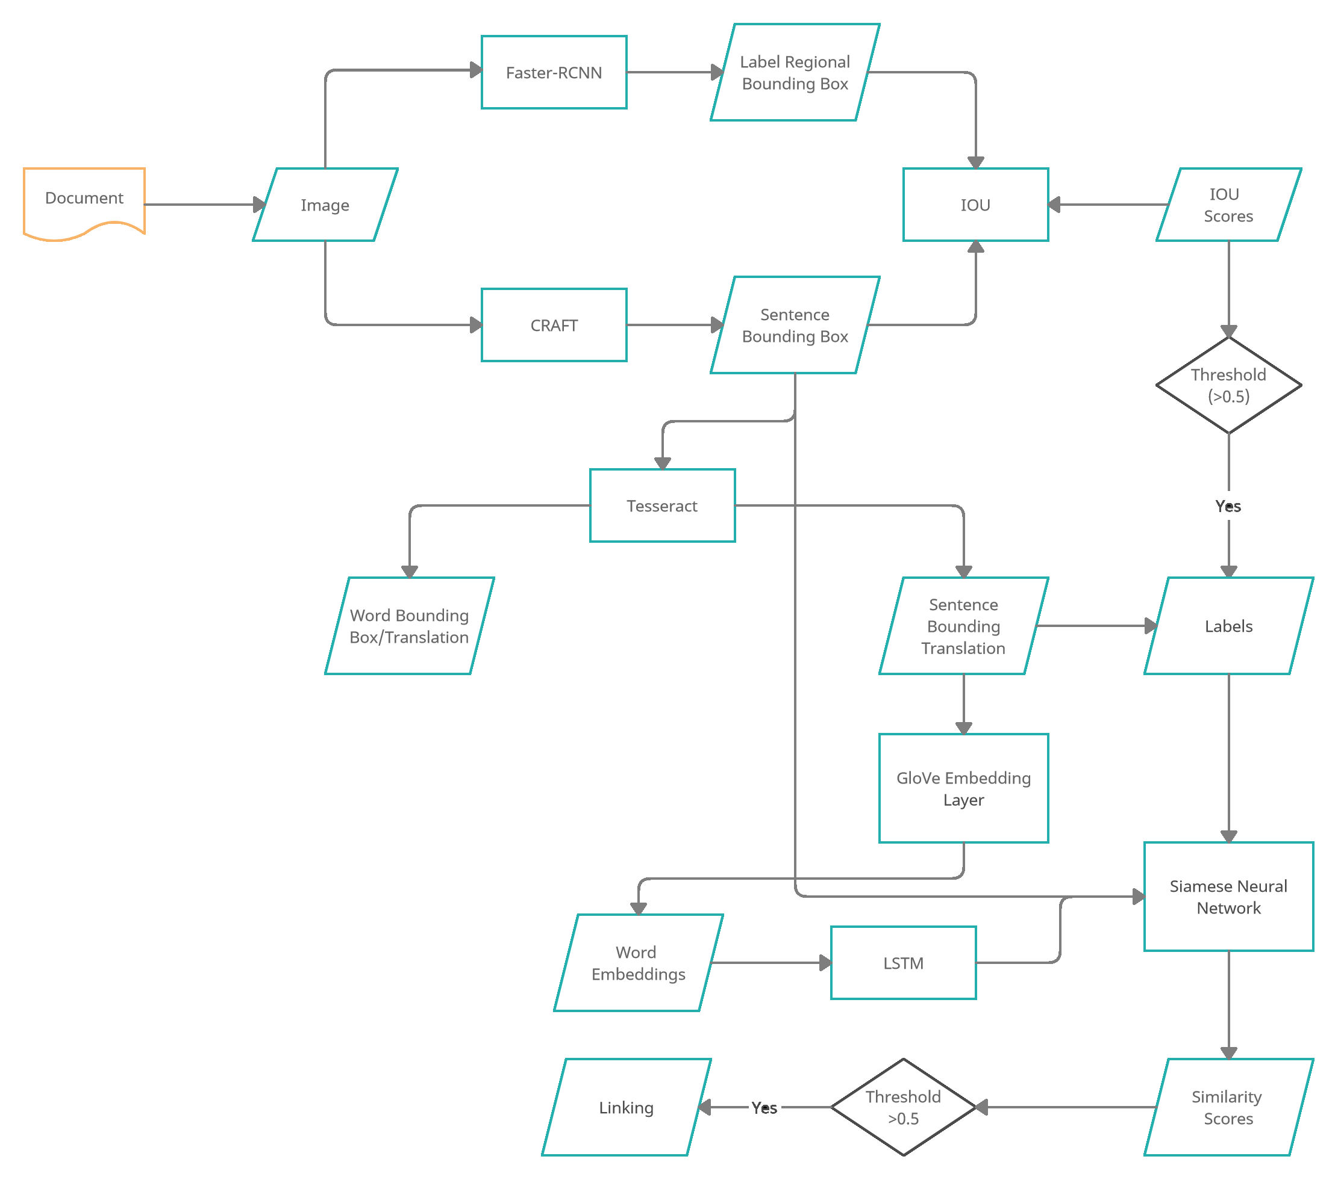
Notes:
First, we are feeding the image of the scanned document into the CRAFT model, which returns bounding boxes for sentences.
Then we feed the image again into the Faster R-CNN model, which in return will give approximate regional bounding boxes of each label category by comparing Intersection Over Union scores against the CRAFT predictions
.Now we will pass each sentence image into the Tesseract model, which will give us bounding boxes of each word and translation for each word and sentence.
Then we will iterate every two sentences and combine the predicted translation of each sentence with a bounding box and label classification feed into Siamese Neural Network, which will give us a similarity score which we will be used to link key-value pairs.

Slide 8
WEB APP
BACKEND :
Flask is used to handle all the requests and to handle transfer data between server and client.
pdf2image library is used to convert pdf files into JPEG format with the help of poppler-utils.
It is then hosted in Azure VM after setting up all the dependencies and requirements in the machine
2) FRONTEND :
Bootstrap, a CSS framework, is used to design a responsive website that is compatible with almost all screen sizes.
Drag and Drop features makes the uploading process easier.
Progress bar informs the user about the current progress in the entire ML pipeline
Annotorious, a Javascript framework, is used to create an interactive UI to adjust or annotate the documents either from the model output or from scratch. Users can also download the final data in the .txt format whenever needed.
Notes:
WEB APP
1) BACKEND :
I am using Flask to handle all the requests sent from the website. I am also using the pdf2image library, which uses poppler-utils to convert pdf files into image files to be fed into the ML model pipeline. Finally, the Flask app is deployed locally or in the Azure VM.
2) FRONTEND :
I used Bootstrap to design a responsive website. I have added the Drag and Drop upload option along with a progress bar. I also used Annotorious, a Javascript framework, to create an interactive UI to adjust or annotate the documents.

Slide 9
MODEL STRUCTURE
CRAFT
Character-Region Awareness For Text detection localizes the individual character regions and links the detected characters to a text instance. It is also multi-lingual, making it easier to expand the project target to multiple languages.
CRAFT adopts a fully convolutional network architecture based on VGG-16 as its backbone. In simple words, VGG16 is essentially the feature extracting architecture used to encode the network’s input into a particular feature representation. The decoding segment of the CRAFT network is similar to UNet. It has skip connections that aggregate low-level features.
Notes:
Character-Region Awareness For Text detection localizes the individual character regions and links the detected characters to a text instance. It is also multi-lingual, making it easier to expand the project target to multiple languages.
CRAFT adopts a fully convolutional network architecture based on VGG-16 as its backbone.
VGG16 is essentially the feature extracting architecture used to encode the network’s input into a particular feature representation. The decoding segment of the CRAFT network is similar to UNet. It has skip connections that aggregate low-level features
CRAFT predicts two scores for each character:
Region Score: As the name suggests, it gives the region of the character. It localizes the character.
Affinity Score: ‘Affinity’ is the degree to which a substance tends to combine with another. So, an affinity score merges characters into a single instance (a word).
CRAFT generates two maps as output: Region Level Map and Affinity Map
Finally, the affinity and region scores are combined to give the bounding box of each word. The coordinates are in the order: (left-top), (right-top) (right-bottom), (left-bottom), where each coordinate is an (x, y) pair.

Slide 10
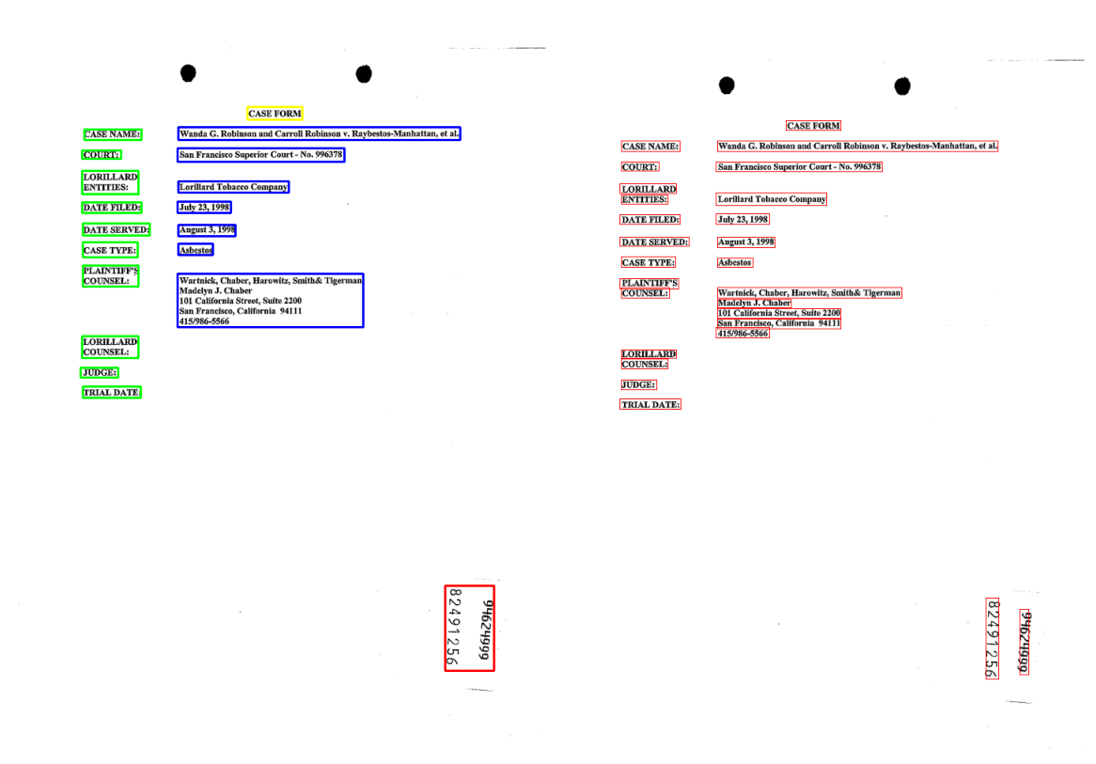


Comparing CRAFT prediction against ground truth
GROUND TRUTH
PREDICTIONS
Notes:
I am using a pre-trained CRAFT model to predict the bounding boxes for each sentence in a scanned document.
You can see that It’s able to classify most of it correctly.
But you can also see that the main drawback with this method is that the model isn’t able to differentiate between a sentence and a paragraph in some cases. This can be avoided by fine-tuning the pre-trained CRAFT model which I haven’t done yet because of the project time constraints and lack of training set.

Slide 11
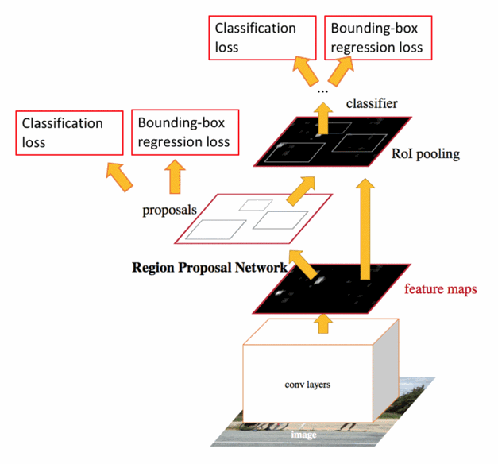
Faster R-CNN
Faster R-CNN is a deep convolutional network used for object detection that appears to the user as a single, end-to-end, unified network. The network can accurately and quickly predict the locations of different objects.
Regional label bounding box outputs from Faster R-CNN and the CRAFT bounding box are used to classify the labels of the sentences by calculating the maximum Intersection Over Union (IOU) value.
Notes:
I am using Faster R-CNN to classify labels. I am using regional label bounding box outputs from Faster R-CNN and CRAFT bounding box to classify the labels of the sentences by calculating the maximum Intersection Over Union (IOU) value between them.

Slide 12
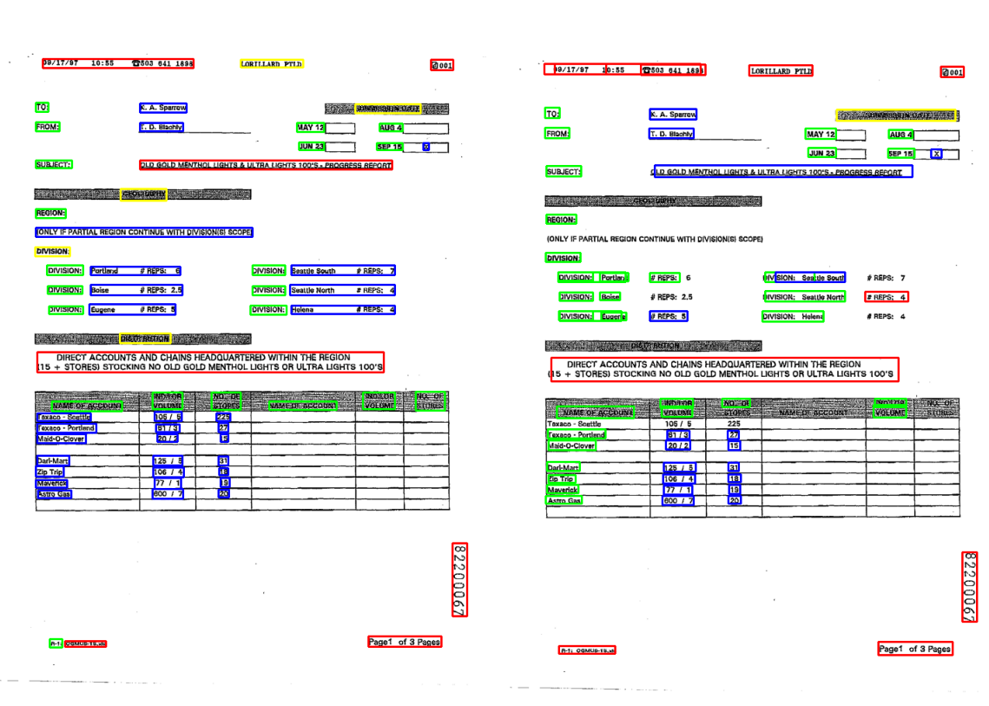

Comparing Faster R-CNN prediction against ground truth
PREDICTIONS
GROUND TRUTH
Notes:
Comparing Faster R-CNN prediction against ground truth
As you can see that the model’s prediction doesn’t accurately cover the entire sentence or word. To solve this problem, I am using Intersection Over Union (IOU) to find the IOU scores against every CRAFT bounding box and assign the label that has maximum IOU scores.

Slide 13
Tesseract
Tesseract is an OCR engine with support for Unicode and the ability to recognize more than 100 languages out of the box. It can be trained to recognize other languages. Tesseract module must be first installed to use it, while Pytesseract library is used to access it using Python.
Image of each sentence ➔ Tesseract ➔Word bounding boxes & translations.
Notes:
Tesseract is an OCR engine with support for Unicode and the ability to recognize more than 100 languages.
I am first feeding the images of each sentence and in return, I am getting each word bounding box and the translation for the whole sentence. I am again feeding images of each word separately to get their translations.

Slide 14

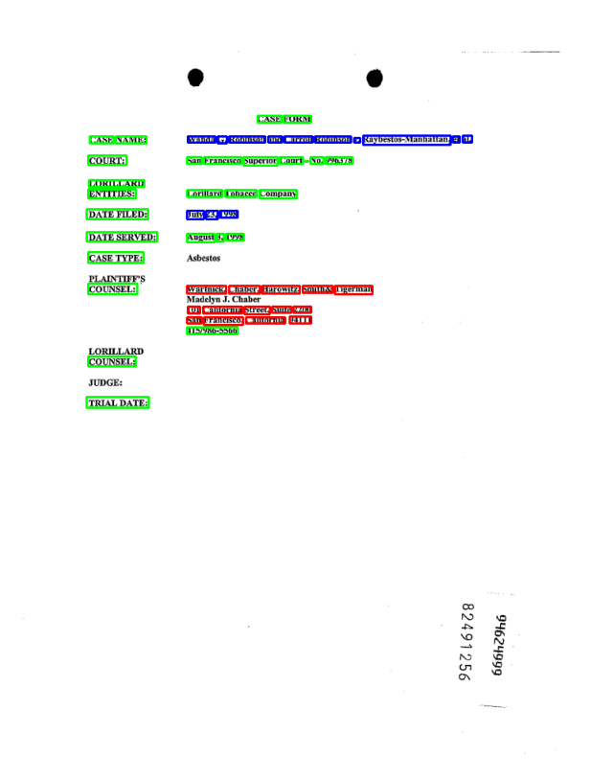
Notes:
The advantage of choosing tesseract instead of other models is its ability to translate, including special characters, and its flexibility to expand the translations to multiple languages.
ou might think why not directly feed the entire document to tesseract, but as you can see here, the tesseract is wildly inaccurate in finding bounding boxes for each word. The translation accuracy also seems to decrease when an entire document is fed.
This is why I am iterating every sentence separately and feeding them to the tesseract model.
Another reason for choosing tesseract instead of other models is its ability to translate, including special characters, and its flexibility to expand the translations to multiple languages.

Slide 15
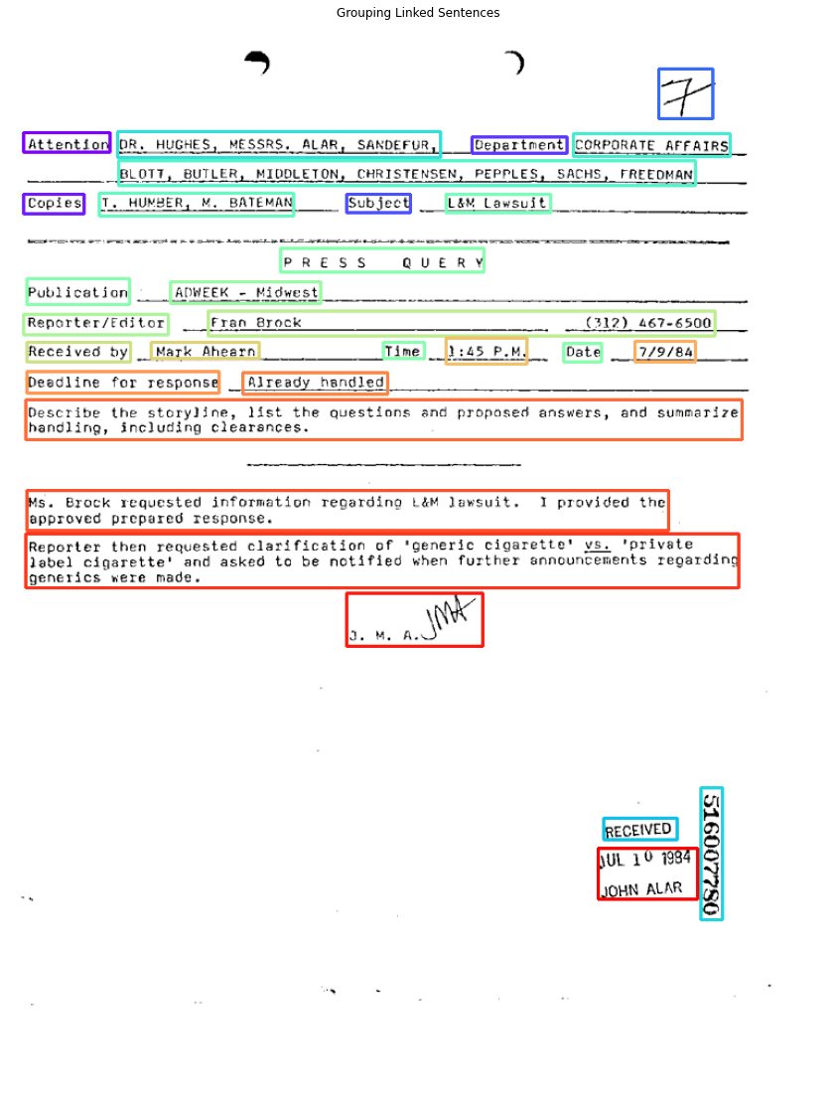
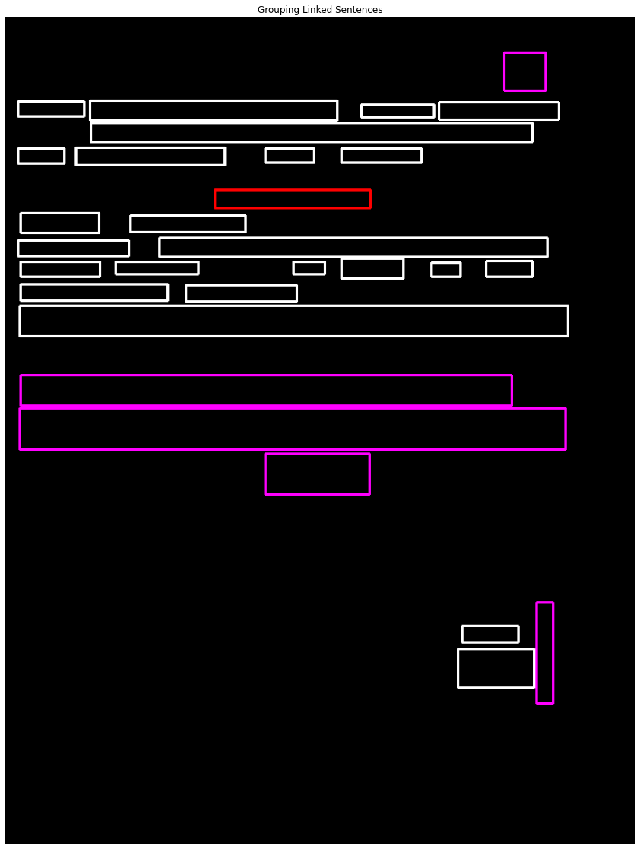
Why do we need each sentence translations ?
Notes:
On the right is the image plotted with the help of the data we have till now, excluding translations (each color represents a different label). With this data, try to find which sentences are linked. You might find it nearly impossible to do without knowing the information or the text inside each sentence bounding box. This is why I am finding the translations and using them to find the key-value relations.
On the left is the image that is plotted based on sentences that are linked. Each relation is represented with a common color

Slide 16
LSTM + Siamese Neural Network :
Long Short Term Memory networks – usually just called “LSTMs” – are a special kind of RNN, capable of learning long-term dependencies. LSTMs are explicitly designed to avoid the long-term dependency problem. It is used alongside the GloVe embedding layer to get the vector representation of each sentence.
Siamese Neural Network is a class of neural network architectures that contain two or more identical subnetworks. ‘identical’ here means they have the same configuration with the same parameters and weights. It is used to find the similarity of the inputs by comparing its feature vectors.
The bounding boxes for each sentence from the CRAFT model, sentence translation from tesseract, label classified using Faster R-CNN, and vector representation of a sentence from GloVe embedding and LSTM layers are fed into the Siamese neural network model.
Bounding boxes + label + translation ➔ LSTM + Siamese Neural Network ➔ Key-Value Linking.
After training, the model can reach a maximum accuracy of about 92.123 % in the public test set.
Notes:
LSTM are a special kind of RNN, capable of learning long-term dependencies. I am combining LSTM with glove embedding layers to create the feature representation of each sentence feature output of shape 30,64 for each sentence
With the help of this we are able to get vector representation for each sentence
In the Siamese model , I am then combining these feature representations with the labels classified and each sentence bounding box coordinates. Then I will find the absolute difference between every two sentences and pass them to Linear layers, finally giving us the similarity score. After training, the model can reach a maximum accuracy of about 92.123 % in the public test set

Slide 17
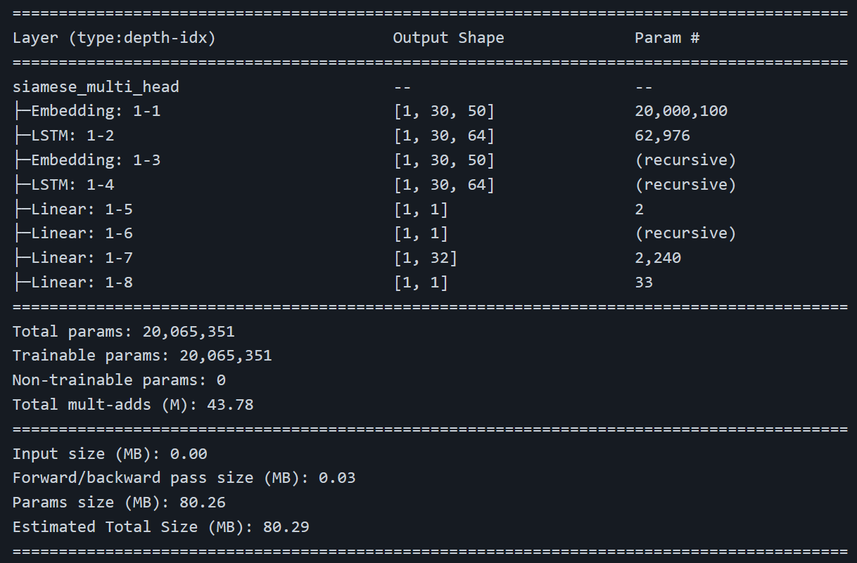
Notes:
This is the PyTorch summary of the LSTM + Siamese model

Slide 18
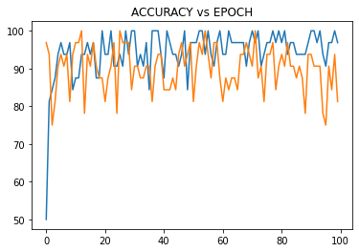
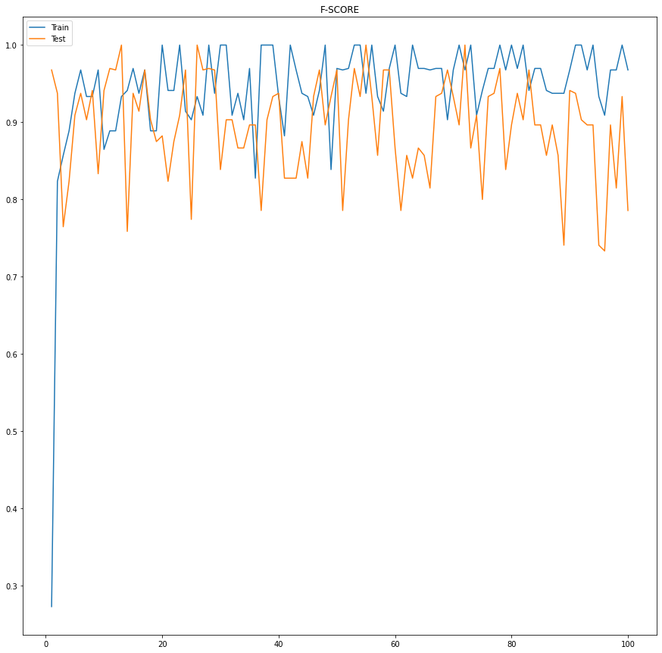
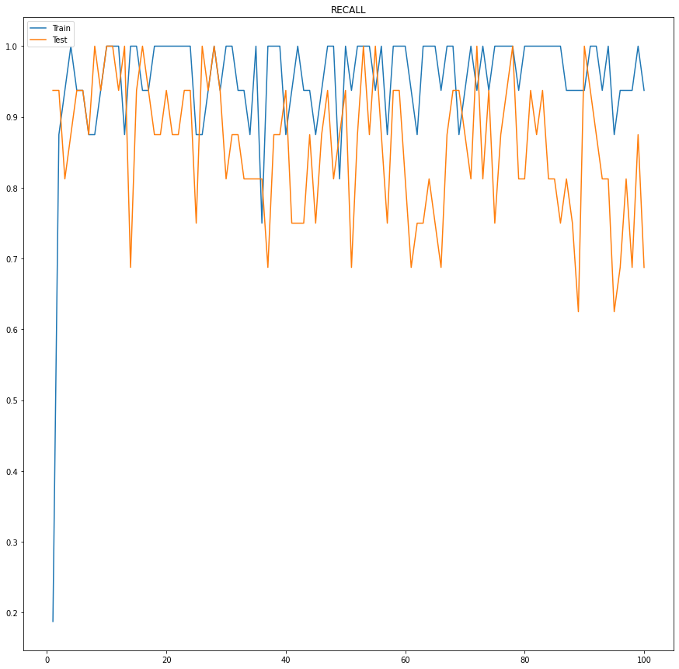
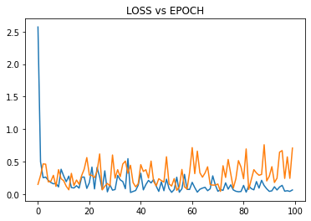
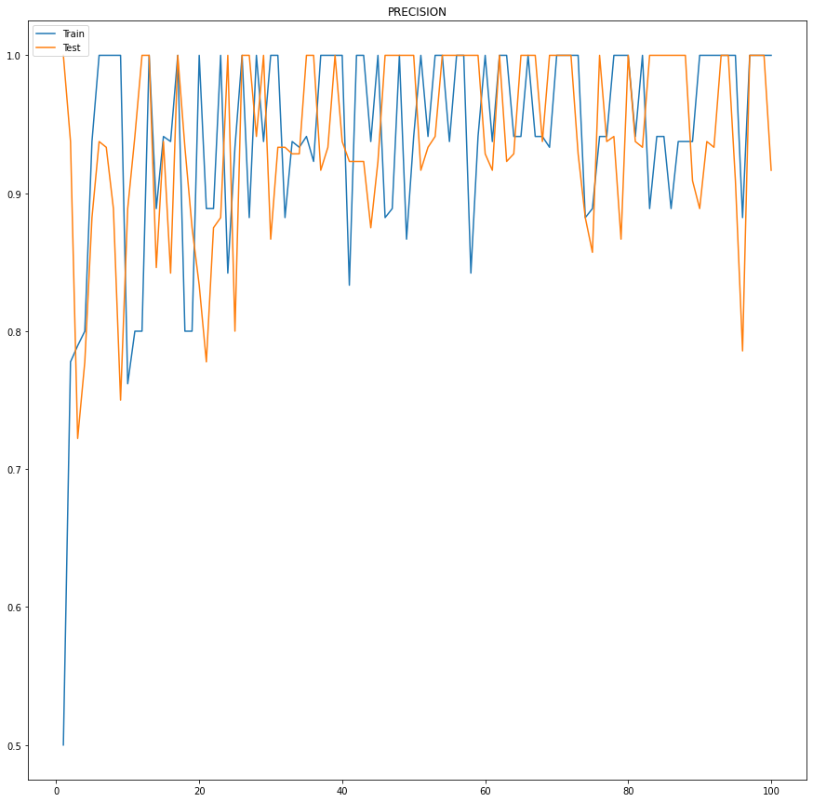
Notes:
These are the metrics from training

Slide 19
Notes:
The main advantage of this model structure is that it’s highly accurate, can be expanded for multiple languages, and works even for uncategorized documents where it doesn’t need to be appropriately labeled or arranged in a structured manner. At the end of the ppt, I will show a video where we upload this flowchart as a pdf input, but it still can link and classify labels.

Slide 20
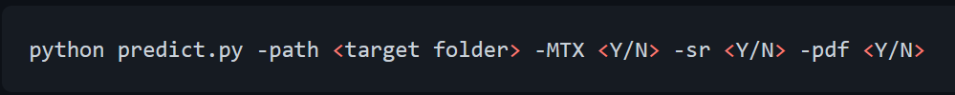
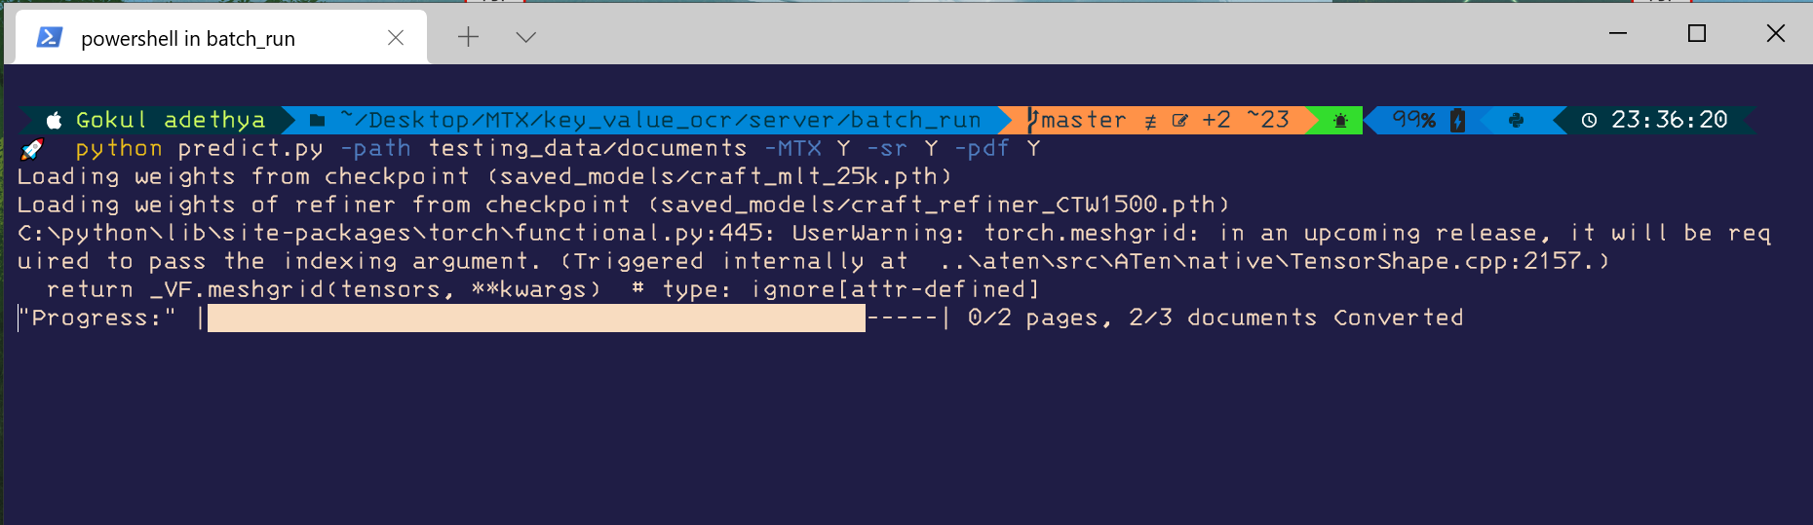
Predict & Evaluate
PREDICT
A separate program for users to predict the target output for multiple documents in either separate images or in pdf format with multiple pages locally.
Notes:
I have combined all the models and made a separate program for users to predict the target output for multiple documents locally with the option to choose the output format as FUNSD or MTX.

Slide 21

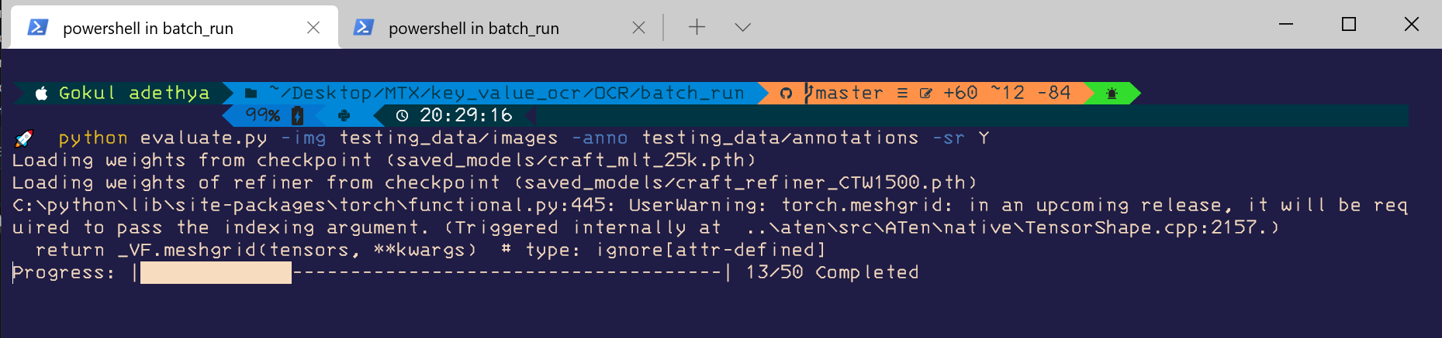
EVALUATE
This program is made to test the overall performance of the linking and label classification algorithms. Annotations and Images need to be saved in separate folders and the result metrics (f-score, recall, accuracy, and precision) are saved in a separate .json file
Notes:
I have made seperate program to test the overall performance of the linking and label classification algorithms.
After looking at the evaluation scores for the linking, you might ask, “Gokul, why are does it seem that accuracy, score, and other values seem to be far less than the results shown while testing the validation dataset? “. The reason is that during training and testing the public test dataset, we assumed that the bounding boxes had been predicted accurately. Still, as you know, the CRAFT model cannot distinguish between paragraphs and sentences. This error is reflected here in linking. And as I mentioned before, these errors can be dramatically decreased if the CRAFT model is fine-tuned with a large dataset

Slide 22
WEB APP
The website is made with the help of the Bootstrap CSS framework, which makes the website more responsive and compatible with most of the screen sizes.
There is the Drag and Drop feature makes the uploading process very easy. The uploaded file can be PDF, PNG, JPEG, JPG. In the case of PDF, only the first page is used to get model output.
There is also a progress bar that helps the user monitor the conversion's progress. After getting the model output, the user can instantly download it in the .txt format or choose to adjust the values using the annotate feature.
User can either use the model output to annotate or start annotating from a scratch document. Annotating documents is very simple and highly flexible. Everything, including translation of each word and sentence, key-value classification, key-value linking, can be adjusted quickly.
Notes:
The website is made with the help of Bootstrap which makes the website more responsive and compatible with most of the screen sizes.
There is Drag and drop and progress bar features
User can either use the model output to annotate or start annotating from a scratch document. Annotating documents is very simple and highly flexible.

Slide 23
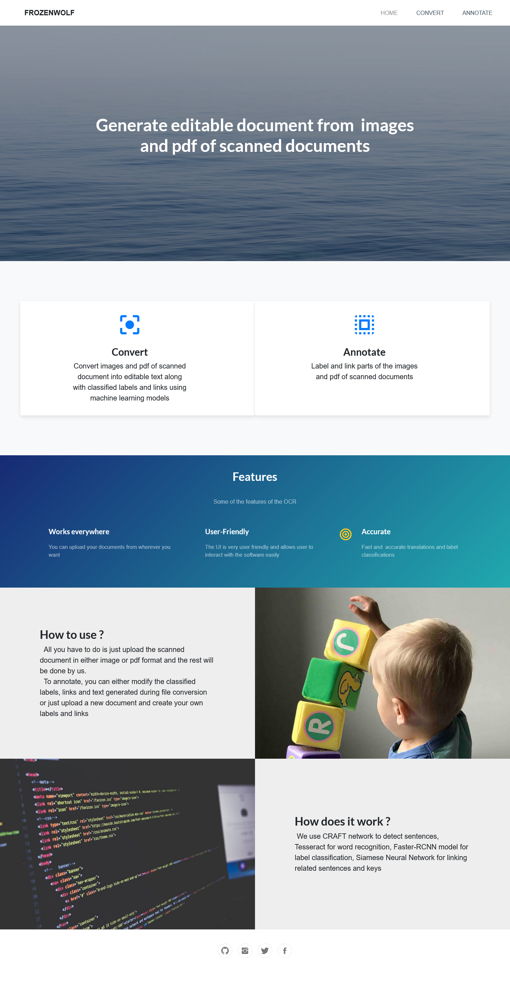
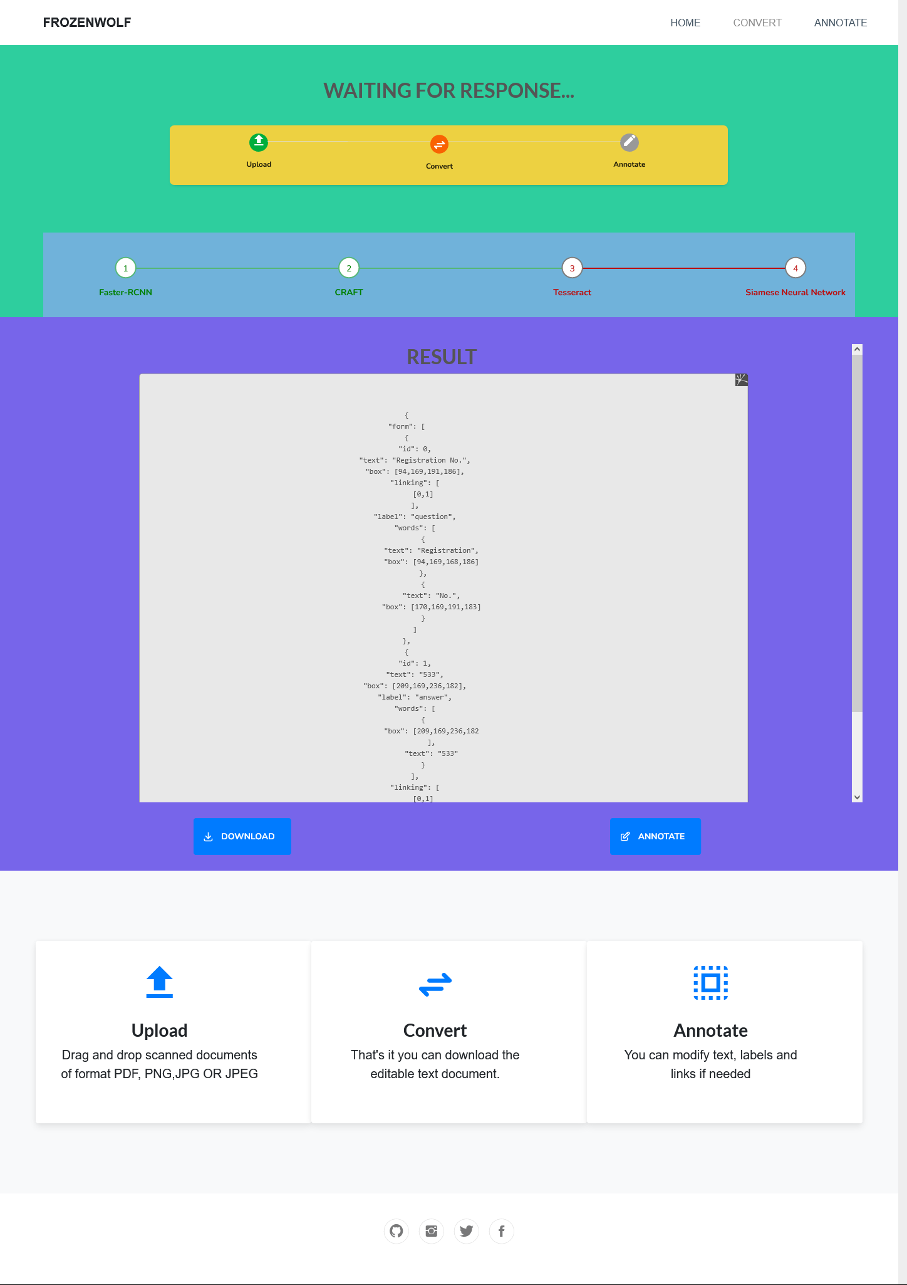
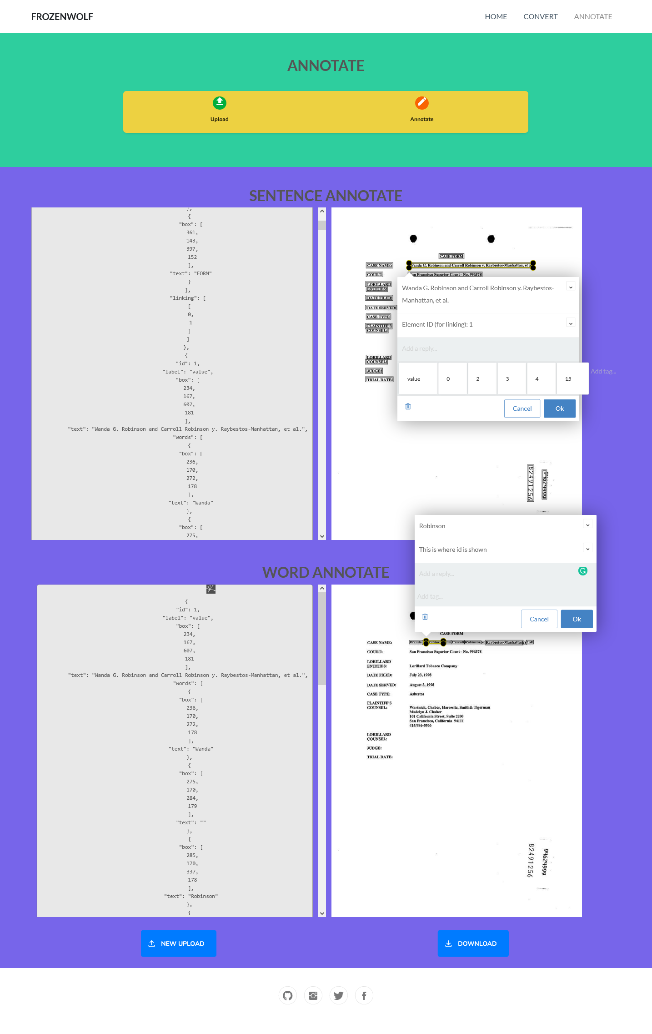
Notes:
This is just the preview of the website

Slide 24

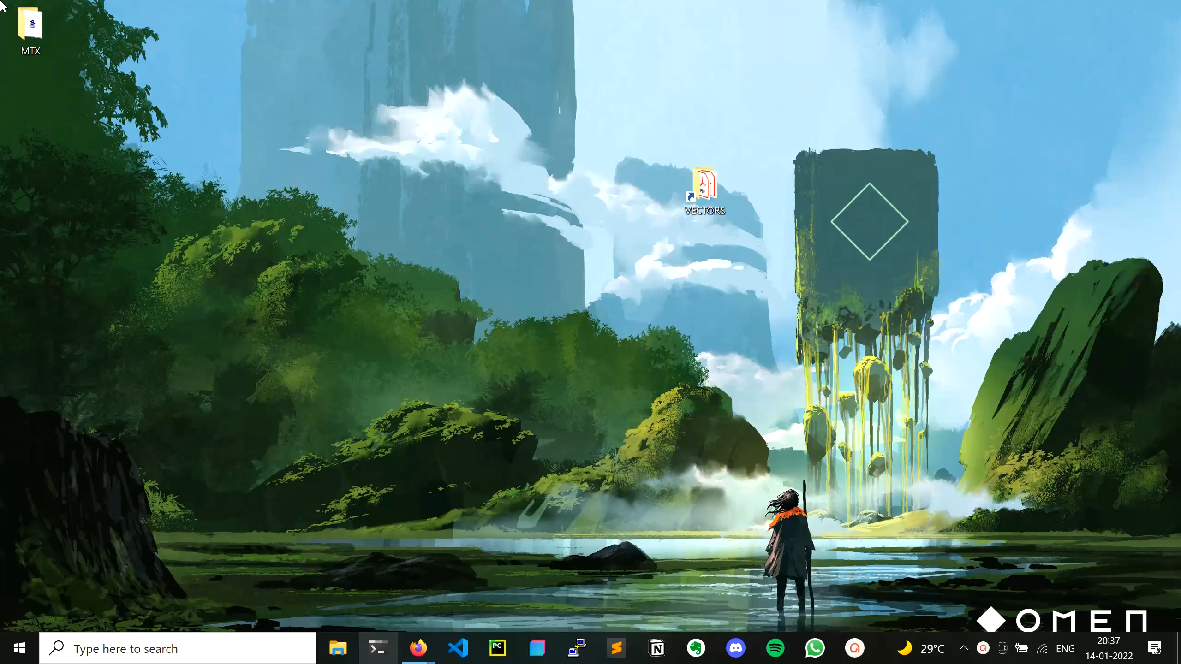
DEPLOYING WEB APP
LOCAL DEPLOYMENT
You can deploy the web app using localhost from your PC easily.
Notes:
I have written separate scripts so that users can quickly start a locally hosted web app.

Slide 25

AZURE VM
The Flask app is deployed in Azure VM because of the requirement of Tesseract and Popper. Also, I am using Standard B2s (2 vcpus, 4 GiB memory) in Azure VM with Linux (ubuntu 18.04) as the operating system. The app has been hosted at :
http://frozenwolf-ocr.westeurope.cloudapp.azure.com:5000/home
Notes:
The Flask app is deployed in Azure VM using Standard B2 with ubuntu 18.04 OS. To deploy the app in VM, I have to follow the same steps I did for local deployment in the VM terminal using putty.

Slide 26

DEMO
Notes:
This video will show how to use the website to convert the file and use the interactive annotation feature.
As you can see, because we are using Bootstrap, the website is more responsive and compatible with different screen sizes.
You can also see that the progress bar informs the user about the current model progress in the ML model pipeline.
Now that the conversion is complete, you can either download the output in .txt format or continue to adjust it using annotate feature
You can see that even though the document wasn’t orderly, it was still able to link and classify labels.
As you can see, the annotate features are straightforward to use and adjust almost everything in the output.
User also has the option to upload documents and annotate from scratch instead of waiting for model output

Slide 27


